Slide 1
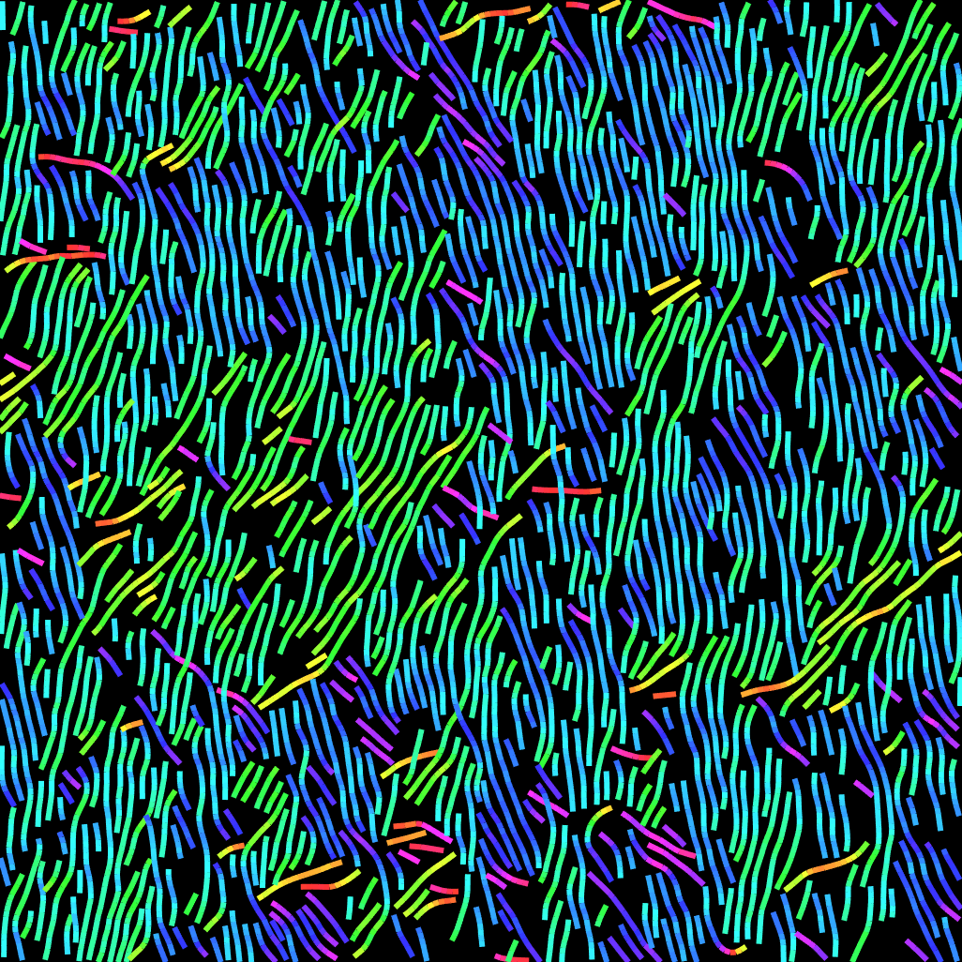
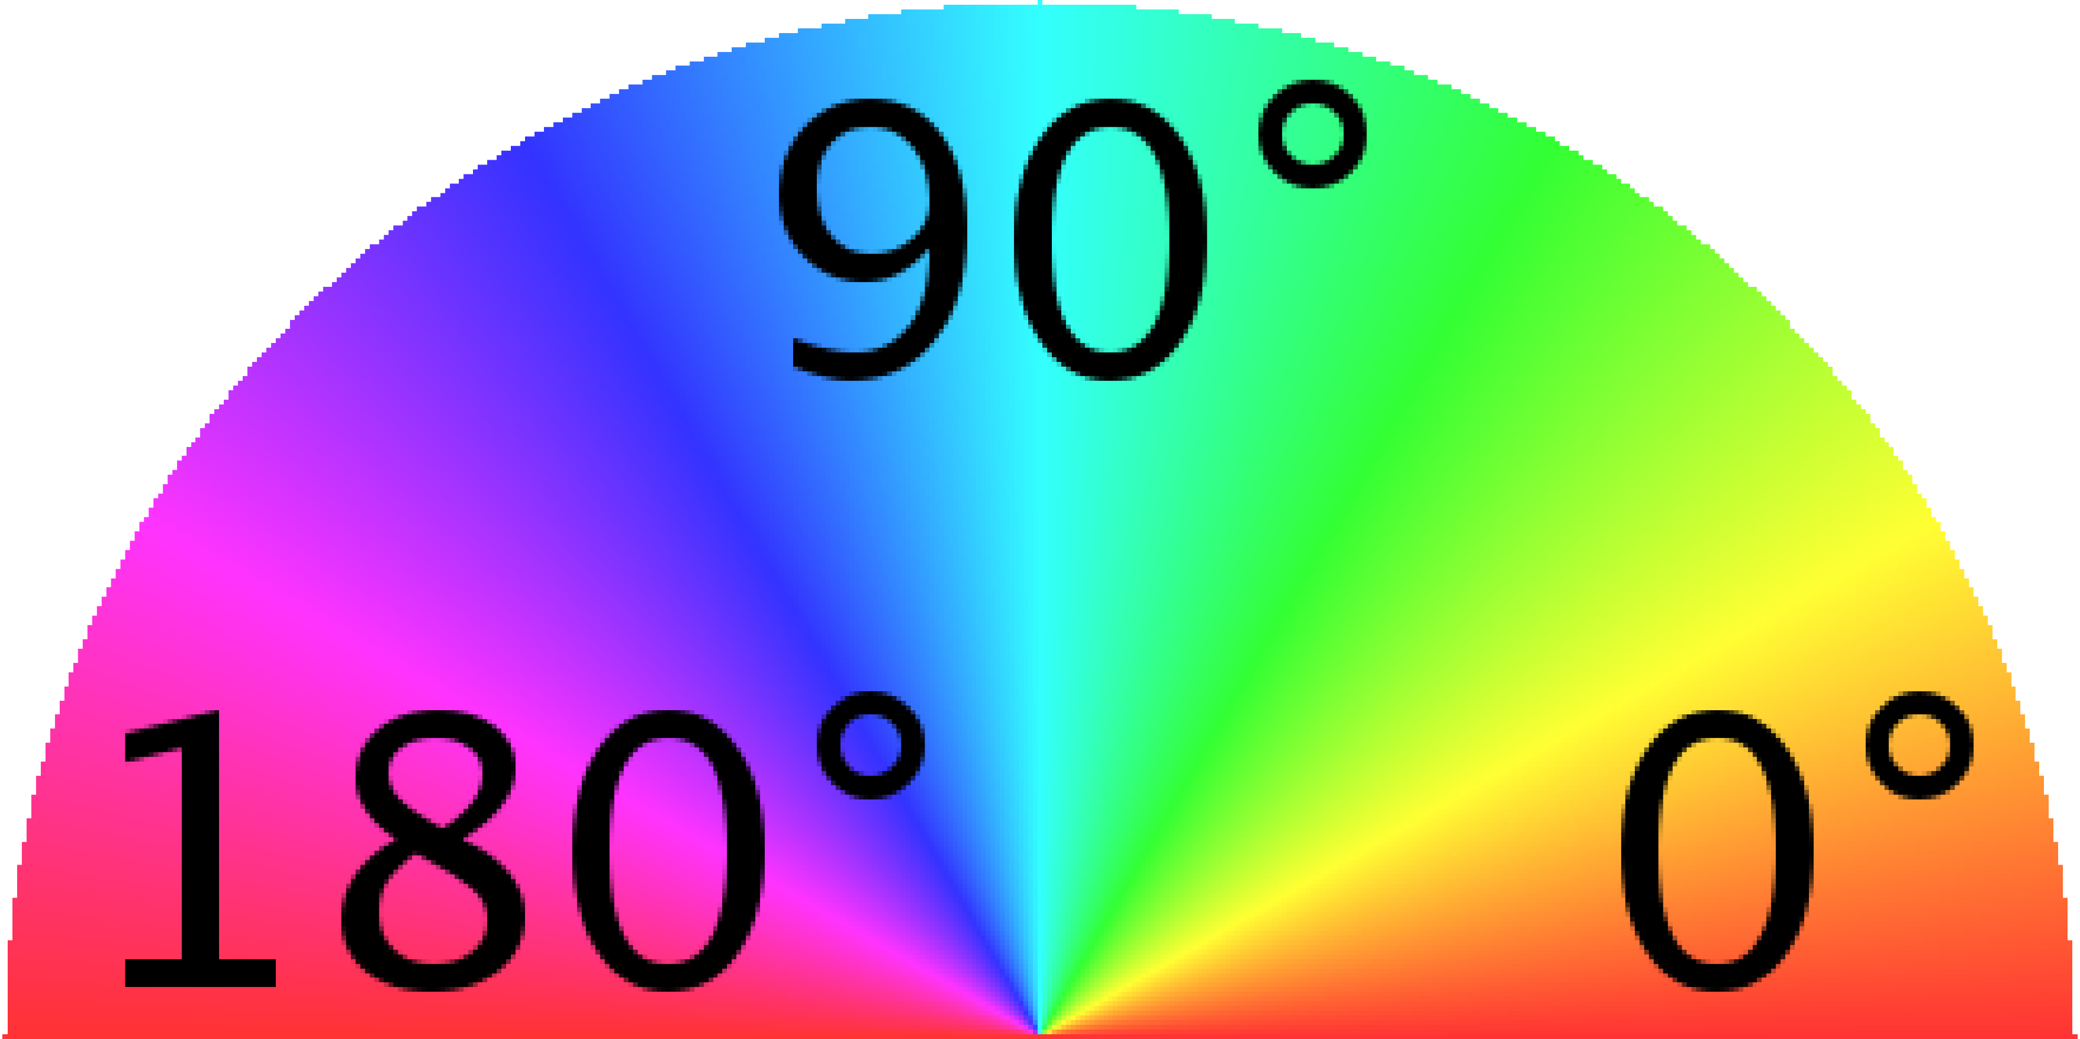
Alignment & Mobility Anisotropy
Nanofiber Preparation
Blade Coated
UV Irradiation
Aging
µ = 0.2
Imaging this interface
(P3HT/SiO₂)
µ = 0.12
1 µm
gtfiber.github.io
Transport through π-π stacks
Backbone transport
* Polymer backbone perpendicular to fiber backbone
+
+
Chu, P.H., Kleinhenz, N., Persson, N. et al., Chem. Mater., 2016, 28, 9099–9109
Persson, N. E. et al. ACS Appl. Mater. Interfaces 2017, 9, 36090–36102.

Slide 2
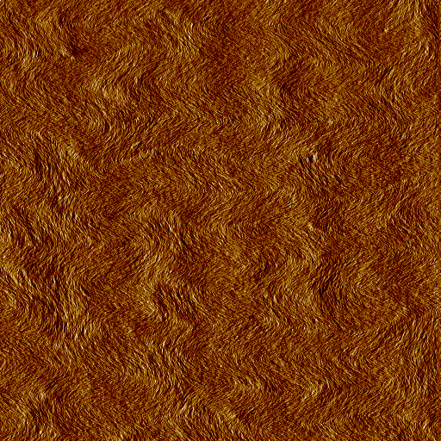
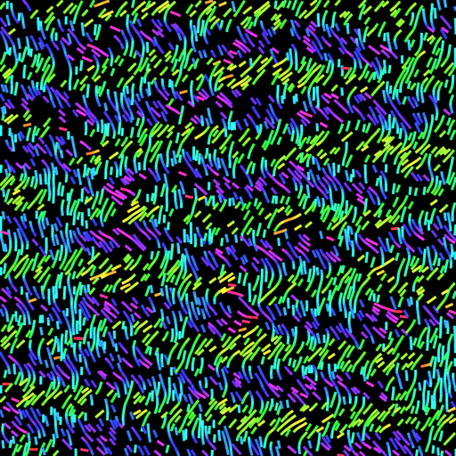
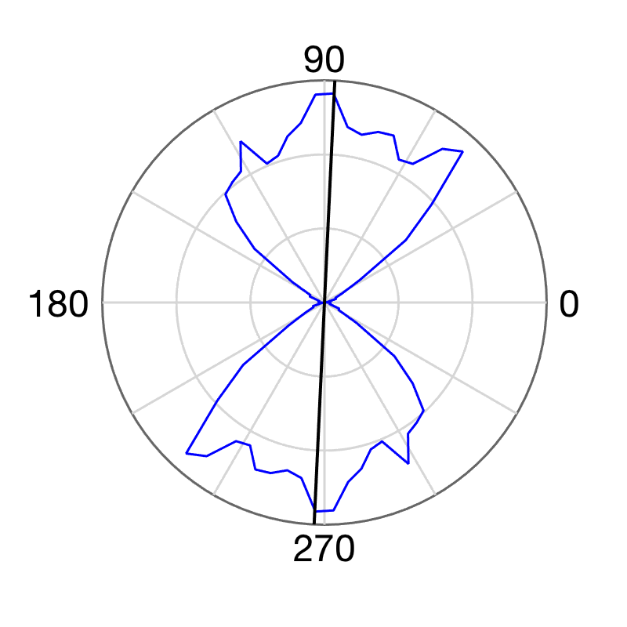
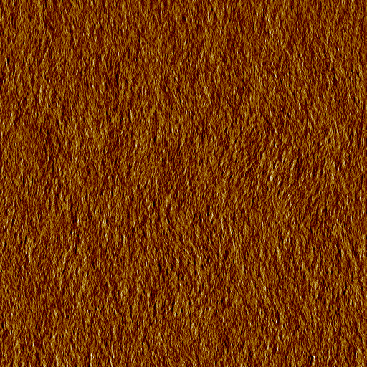
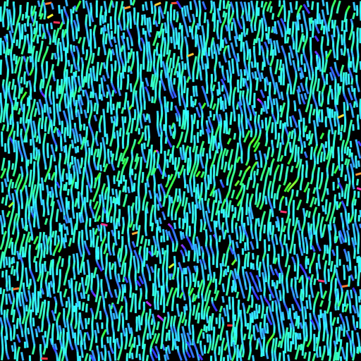
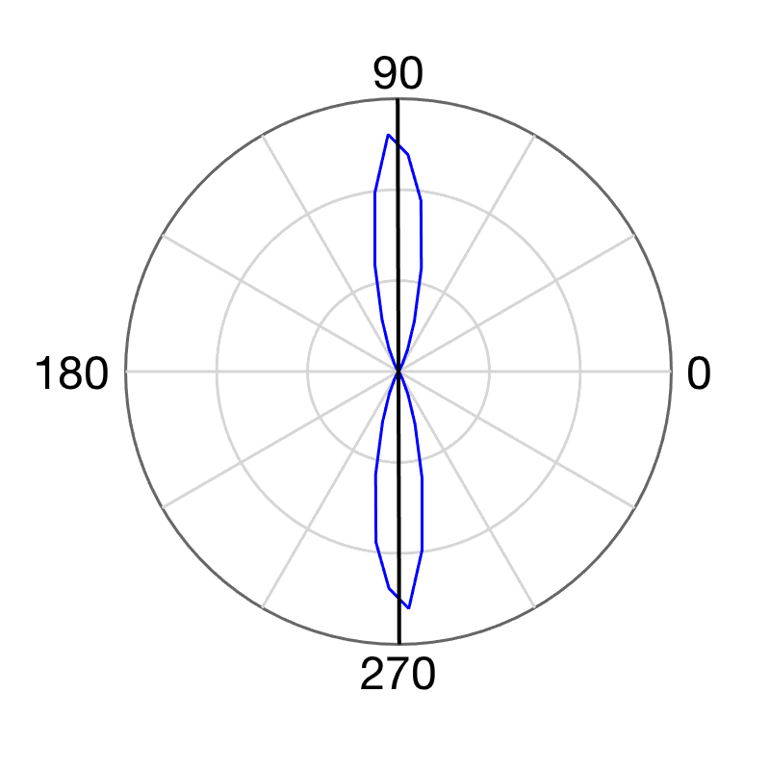
Alignment & Mobility Anisotropy
P(NDI2OD-T2) – n-type semiconducting polymer – polymer backbone || fiber backbone
0.05 mm/s
Charge
Transport
Coat
2 µm
5 mm/s
gtfiber.github.io
Persson, N. E. et al. ACS Appl. Mater. Interfaces 2017, 9, 36090–36102.

Slide 3
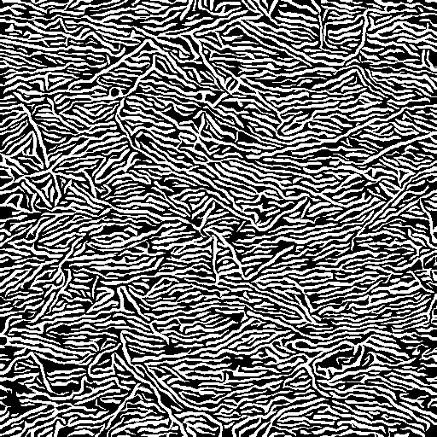
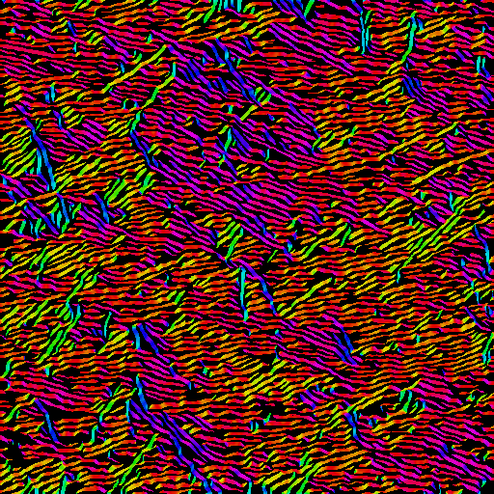
Data Structures
Original Image
Data: <image name>_bw_array.txt
Data: <image name>_acm_array.txt
512 x 512 (original AFM resolution)
Grayscale
P3HT: 5 um image (10 x 10 nm pixels)
N2200: 10 um image (20 x 20 nm pixels)
Same resolution
Pixel is white (1) if it’s a fibrillar (crystalline) region
Same resolution
Every pixel has an orientation between
[-90, +90), in degrees off of the horizontal
But, in the image above, the color is only plotted for fibrillar pixels (for clarity)
There is no directionality to the orientation: θ = θ + 180
P3HT: chain backbone perpendicular to fibril orientation
N2200: chain backbone parallel to fibril

